Slide 1

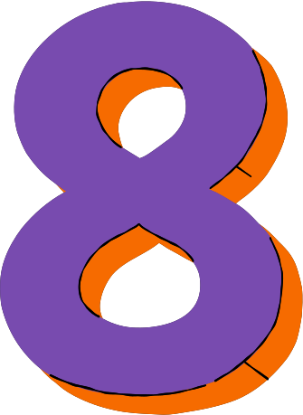
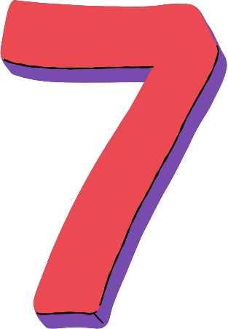

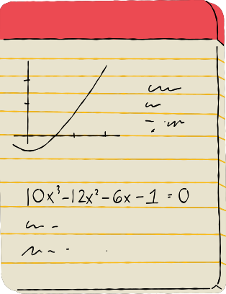





MINIST DIGIT RECOGNIZER

Slide 2


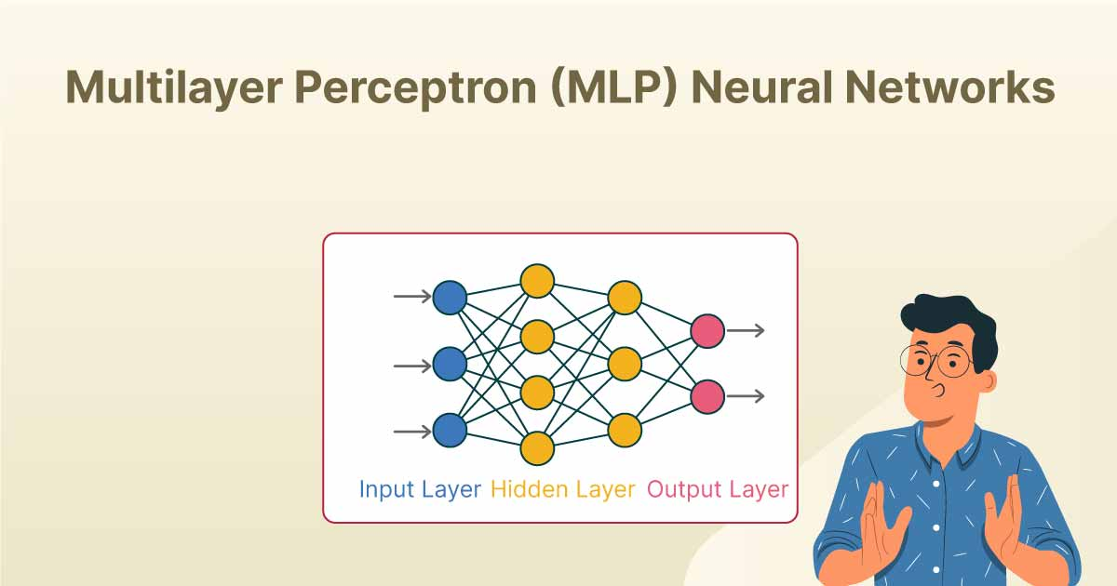
Best fitting model:
A Multilayer Perceptron (MLP)

Slide 3
Data preprocessing
  1
Image Reshaping:
Images reshaped from (28, 28) to 1D vector (784 features) to fit into a fully connected neural network.
  2
Image normalization:
  3
Pixel values scaled from [0, 255] to [0, 1] to improve training stability and speed.
  3
One-hot encoding:
Labels converted from integers (0–9) to a binary vector (10 classes) for compatibility with the categorical_crossentropy loss function.

Slide 4







Model Archeticture
  Input Layer: 784 neurons (flattened image).
  Hidden Layers: Dense(512, ReLU) +Dropout(0.2)
Dense(256, ReLU) + Dropout(0.2)
Dense(128, ReLU) + Dropout(0.2)
  Output Layer: Dense(10, Softmax)
  Optimizer: Adam (LR = 0.001)
  Early Stopping

Slide 5
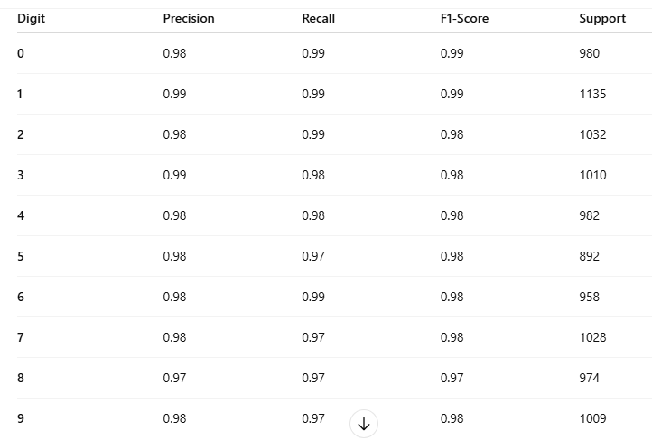
Model performance
Classification Report:
Accuracies:
Training Accuracy was approximately 99%
Testing Accuracy was approximately 98%
2

Slide 6
Gradio App

Slide 7
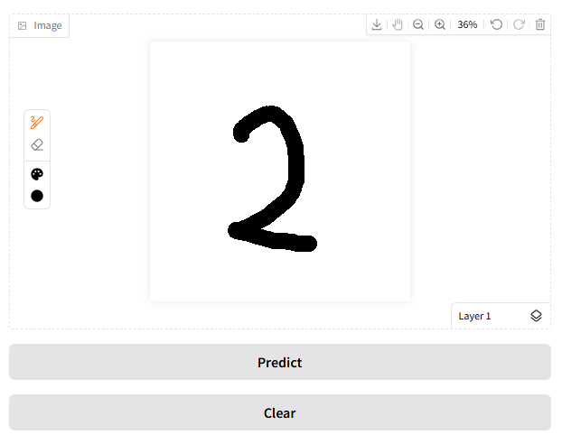

what digit is it?
First, the user draws a number on the sketchpad and then clicks the Predict button
C

Slide 8
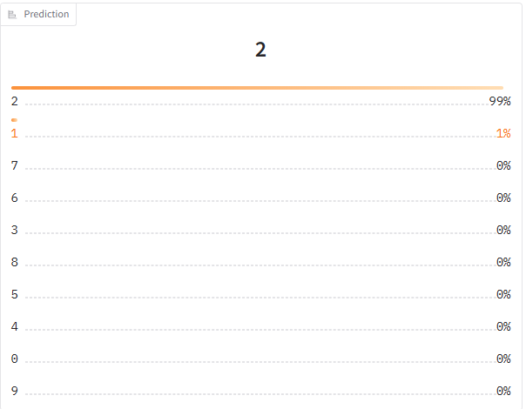
Model predection
The output will display the model's top ten predictions along with the confidence percentage for each.
C

Slide 9
what went wrong?

Slide 10
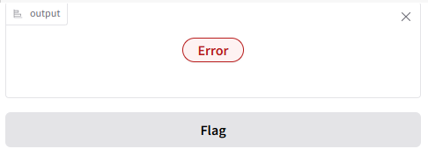
OBSTACLE
  1
gradio output returns error
AttributeError: 'dict' object has no attribute 'reshape'
Adjusted the prediction function to handfle both PIL image or Dictionary inputs on sketchpad
FIX:

Slide 11

OBSTACLES
  2
Inaccurate predictions on Specific Digits
like (3,4,5,9)
FIX:
C
Data Augmentation with ImageDataGenerator:
used TensorFlow’s ImageDataGenerator to artificially expand training data.

Slide 12
Future Work & Improvements
Improve model to detect Multi-Language & Multi-Script Support (Arabic numerals, English letters, etc)
  1
  2
  Combine with OCR or Document Processing

Slide 13
Thank you :)

